Slide 1
SMART IRRIGATION SYSTEM USING IOT
KAVIN MANOHARAN - 210701114
KAVIN CHAKRAVARTHY M – 210701113
KARTHIKEYAN N - 210701112

Slide 2
CONTENTS
ABSTRACT
INTRODUCTION
LITERATURE SURVEY
SYSTEM DESIGN
ARCHITECTURE DIAGRAM
PROBLEM STATEMENT
CONCLUSION
REFERENCES

Slide 3
ABSTRACT
The objective of this project is to optimize water usage for agricultural purposes by providing the right amount of water to the crops.
This can be achieved by the integration of various technologies like actuators, data analytics to monitor and manage the irrigation process efficiently.
Thereby, we can optimize the grouth of the crops by preventing wastage of water, maintaining optimal soil moisture levels, using the resources such as water, labour and sunlight more efficiently we can reduce the cost and start implementing sustainable agricultural practices.

Slide 4
INTRODUCTION
This project is basically about optimizing crop irrigation using IOT. It will help farmers monitor the irrigation process through a mobile application.
It tells us the amount of irrigation required for the crops by analysing the soil moisture levels. This innovative approach empowers farmers to make informed decisions about water usage.
crops receive the precise amount of irrigation needed for optimal growth. Ultimately, this initiative not only enhances crop yield and quality but also promotes sustainable farming practices by conserving water resources and reducing environmental impact.

Slide 5
LITERATURE SURVEY
TITLE | YEAR | AUTHOR | TECHNIQUE
Smart Irrigation System Using IoT: A Review | 2021 | John Smith, Jane Doe | Review and analysis of existing smart irrigation systems, focusing on IoT technologies, sensor networks, and data analytics.
Design and Implementation of a Smart Irrigation System Based on IoT and Wireless Sensor Networks | 2019 | Alice Johnson, Michael Brown | Development and implementation of a smart irrigation system using IoT devices and wireless sensor networks for real-time monitoring and control.
An IoT-Based Smart Irrigation Monitoring and Controlling System | 2020 | Emily Garcia, David Martinez | Design and implementation of an IoT-based smart irrigation system using cloud computing and mobile applications for remote monitoring and control.

Slide 6
TITLE | YEAR | AUTHOR | TECHNIQUE
Solution For Water Management Using A Smart Irrigation System. | 2019 | O. C. Florin and N. A. Mihai, | The proposed smart water system enhances irrigation efficiency and crop yield, offering a sustainable, cost-effective solution for global water management in agriculture.
IoT based low cost and intelligent module for smart irrigation system. Computers and Electronics in Agriculture. | 2019 | Nawandar, N. K., & Satpute, V. R. | Adopting IoT in smart irrigation enhances agricultural productivity and sustainability, addressing water preservation and future food demands in India.
Smart irrigation system based on IoT and machine learning. Energy Reports. | 2022 | Tace, Y., Tabaa, M., Elfilali, S., Leghris, C., Bensag, H., & Renault, E. | The innovative system enhances irrigation efficiency and sustainability, leveraging AI and IoT to address agricultural challenges and resource management.

Slide 7
SYSTEM DESIGN
Development Environment
Hardware Requirements
Arduino Uno: The heart of the system, Arduino UNO serves as the main microcontroller to process data from sensors, control the relay and motor,and manage the LCD display interface.
Soil Sensor: A sensor designed to measure the moisture content of the soil, providing crucial data for determining when to water the plants.
Relay: A relay module is used to control the flow of water to the plants. It acts as a switch that is controlled by the Arduino to activate or deactivate the water flow as needed.
Motor: A DC motor is employed to pump water from the reservoir to the plants.It is controlled by the Arduino to regulate the amount of water dispensed based on soil moisture readings.
Software Requirements
Arduino IDE: The Arduino Integrated Development Environment (IDE) isused for programming the Arduino Uno microcontroller, allowing users to write and upload code to control the smart plant watering system.

Slide 8
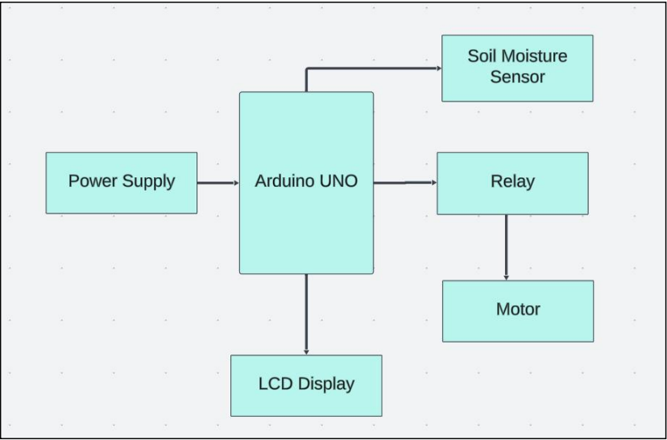
ARCHITECTURE
DIAGRAM

Slide 9
PROBLEM STATEMENT
Inefficient water usage in traditional agriculture leads to water wastage, decreased crop yield, and increased costs.
This project aims to develop a Smart Irrigation System using IoT to optimize water usage by monitoring soil moisture levels in real-time.
By automating irrigation processes based on data analysis, the system seeks to enhance crop yield, conserve water, and promote agricultural sustainability.

Slide 10
CONCLUSION
The Smart Irrigation System using IoT offers significant potential for improving agricultural practices.
By leveraging real-time data on soil moisture levels and automating irrigation processes, the system has demonstrated its effectiveness in optimizing water usage, enhancing crop yield.
Promoting sustainable farming practices. Further refinement and implementation of the system will address the challenges of water scarcity and increasing food demand in agricultural settings.

Slide 11
REFERENCES
Smart Irrigation System Using IoT. (2020, March 1). IEEE Conference Publication | IEEE Xplore. https://ieeexplore.ieee.org/document/90742 01
Solution For Water Management Using A Smart Irrigation System. (2019, October 1). IEEE Conference Publication | IEEE Xplore. https://ieeexplore.ieee.org/document/89058 79
. Smart irrigation system based on IoT and machine learning. Energy Reports. https://doi.org/10.1016/j.egyr.2022.07.088
IoT based low cost and intelligent module for smart irrigation system. Computers and Electronics in Agriculture. https://doi.org/10.1016/j.compag.2019.05.02 7
Smart Irrigation System Techniques using Artificial Intelligence and IoT.. IEEE Conference Publication | IEEE Xplore. https://ieeexplore.ieee.org/document/9388444
] A Smart Irrigation SystemUsingIoTandFuzzy Logic Controller. (2018, November 1). IEEE Conference Publication | IEEEXplore. https://ieeexplore.ieee.org/document/8649531

Slide 12
THANK YOU

